Slide 1

Machine Learning Modelling to Predict the Efficacy of Cancer Treatment Drugs
Edicon Chan, Leon Edmiidz, Jacob Hambly, Zach Ribau
University of Guelph - ANSC*6100
April 15, 2024
ANNU 306
Notes:
~10 seconds

Slide 2

Outline
Introduction to problem
Previous research
Objective
Significance of current analysis
Data used
Data pre-processing
Feature engineering
Algorithms evaluated
Results
Hyperparameter optimization
Feature importance
Discussion/Conclusion
https://www.labiotech.eu/best-biotech/ai-drug-discovery-companies/
Notes:
~20-30 seconds

Slide 3

Introduction to problem
The cycle of drug development is a long and costly process
Only 10-20% of drugs receive patient approval
Can machine learning aid in drug development?
https://zageno.com/blog/six-time-saving-tech-driven-methods-speeding-drug-development

Slide 4
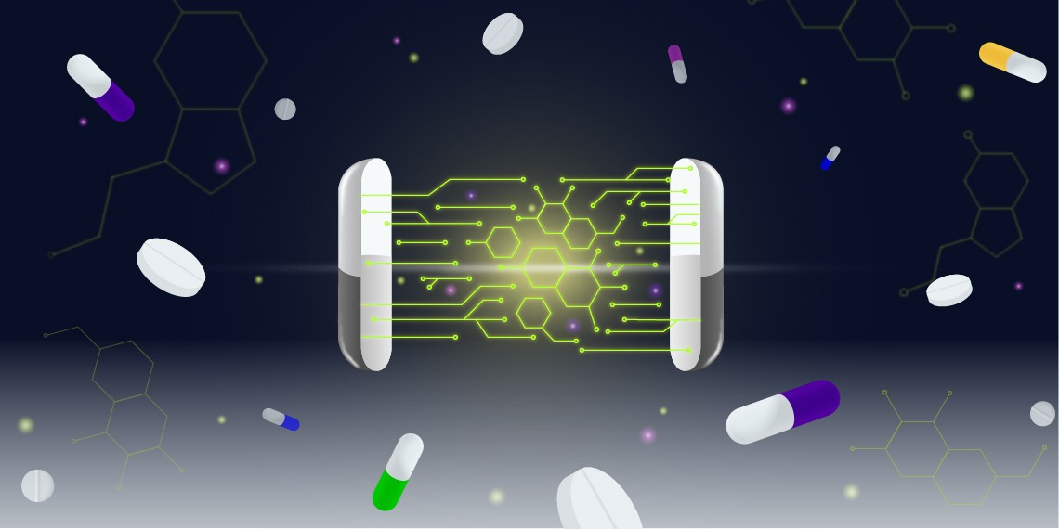
ML in drug development
Integration of AI into the drug development cycle is on the rise
High throughput screening (HTS) is commonly used
HTS can lead to false positives
Machine learning models have shown promise in the screening of potential inhibitory compounds.
We wanted to test this proof of concept

Slide 5
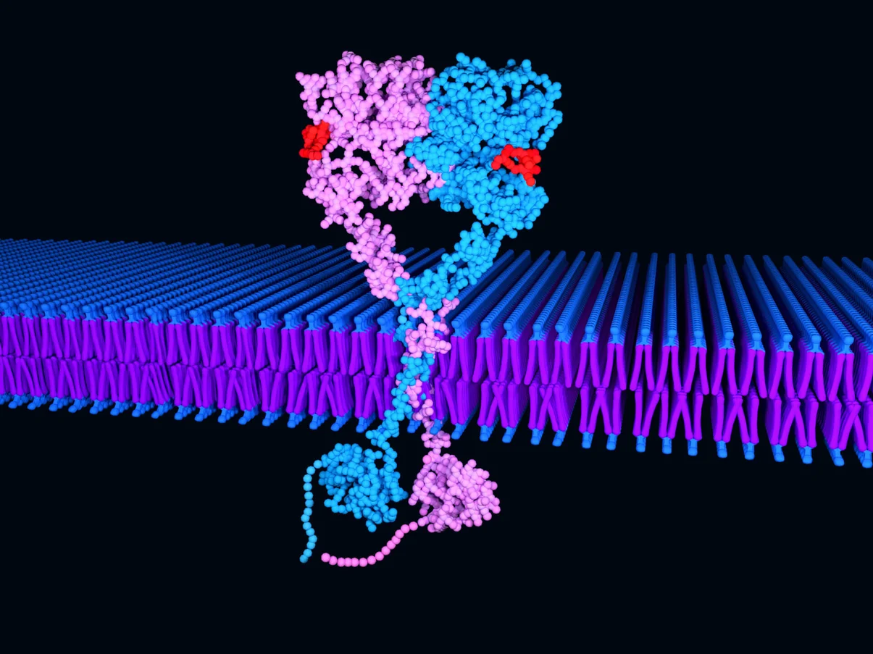
Previous research (EGFR)
Studies have shown that overabundance of EGFR can lead to several types of cancer
Cell proliferation is initiated by EGFR
Classification model for EGFR protein-inhibitor bound complex (Zhao et al., 2017)
https://blog.crownbio.com/egfr-exon20-insertion-osimertinib-response

Slide 6
Objective
Build a regression-based supervised predictive model to:
Quantitatively assess the inhibitory strength of a compound against EGFR based upon its chemical structure/physicochemical properties.
Evaluate the most impactful features for inhibitory strength prediction

Slide 7
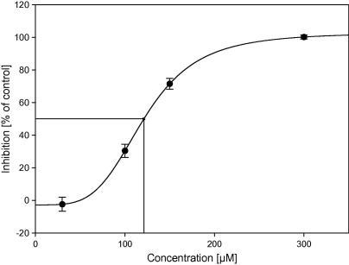
Significance of our analysis
Regression modelling to predict continuous quantitative feature
Half maximal inhibitory concentration (IC50)
Inhibition of EGFR
Potential to identify specific chemical features that affect IC50
Blunder, M., Hurkes, N., Spirk, S., List, M., & Pietschnig, R. (2011). Silanetriols as in vitro inhibitors for Ache. Bioorganic &amp; Medicinal Chemistry Letters, 21(1), 363–365. https://doi.org/10.1016/j.bmcl.2010.10.139
Notes:
Improve predictive resolution via regression modeling of a continuous, quantitative measure: IC50
Concentration required to inhibit a certain biochemical process, EGFR in this case
Analyzing feature importance → Reveal specific chemical features of importance

Slide 8
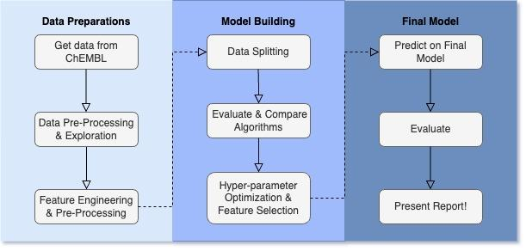
Workflow
Notes:
Here’s the basic workflow
Split up into 3 main sections

Slide 9

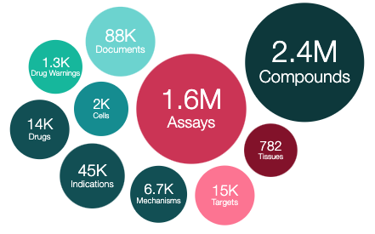
Data used
ChEMBL
Database for bioactive chemicals
Drug-discovery platform
Simplified Molecular Input Line Entry System (SMILES)
IC50 for EGFR inhibiting cancer treatment drugs
Chembl Database. EMBL-EBI homepage. (n.d.). https://www.ebi.ac.uk/chembl/
Notes:
Chemical Biology Database, ChEMBL for short.
Widely used drug-discovery platform
Obtained SMILES for various drugs and respective IC50 values

Slide 10
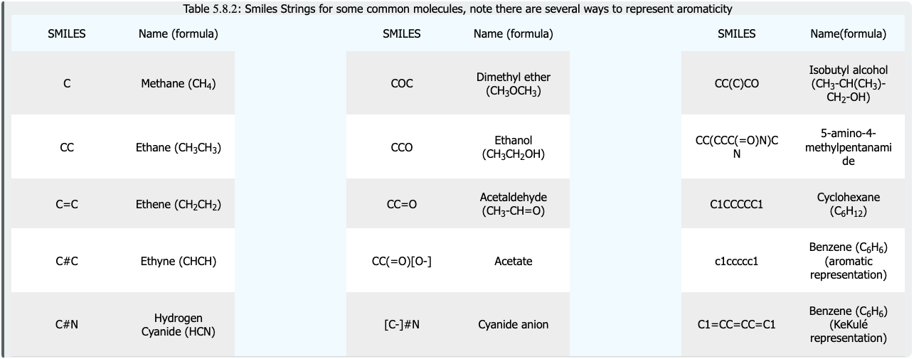
SMILES Example
Libretexts. (n.d.). 5.8: Line notation (smiles and inchi). Chemistry LibreTexts. https://chem.libretexts.org/Courses/Fordham_University/Chem1102%3A_Drug_Discovery_-_From_the_Laboratory_to_the_Clinic/05%3A_Organic_Molecules/5.08%3A_Line_Notation_(SMILES_and_InChI)
Notes:
Allows you to type out the chemical structures of compounds
No H? → # of Hydrogens are interpreted based on the bonds and available valence electrons of the atoms

Slide 11

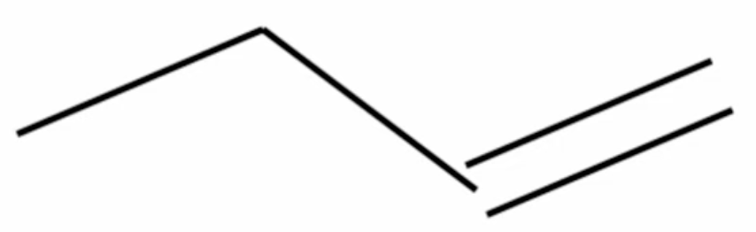
Data Preprocessing
Gather data using the ChEMBL python package
Search for EGFR and filter for IC50
Canonical SMILES
Remove:
Cells with NA
Duplicate (ChEMBL ID & Canonical SMILES)
Outliers
Convert IC50 values to -log10(M)
2 assay formats (bao_labels)
Single protein
Cell based
Butene
Notes:
Once we got the data, we had to make sure the SMILES were canonical (Explain using the figure on the right)
Clean the data (NA, dups, outs)
Transformed IC50 via -log() to represent them on a more interpretable scale
Split data based on the assay type (in vitro and vivo)

Slide 12
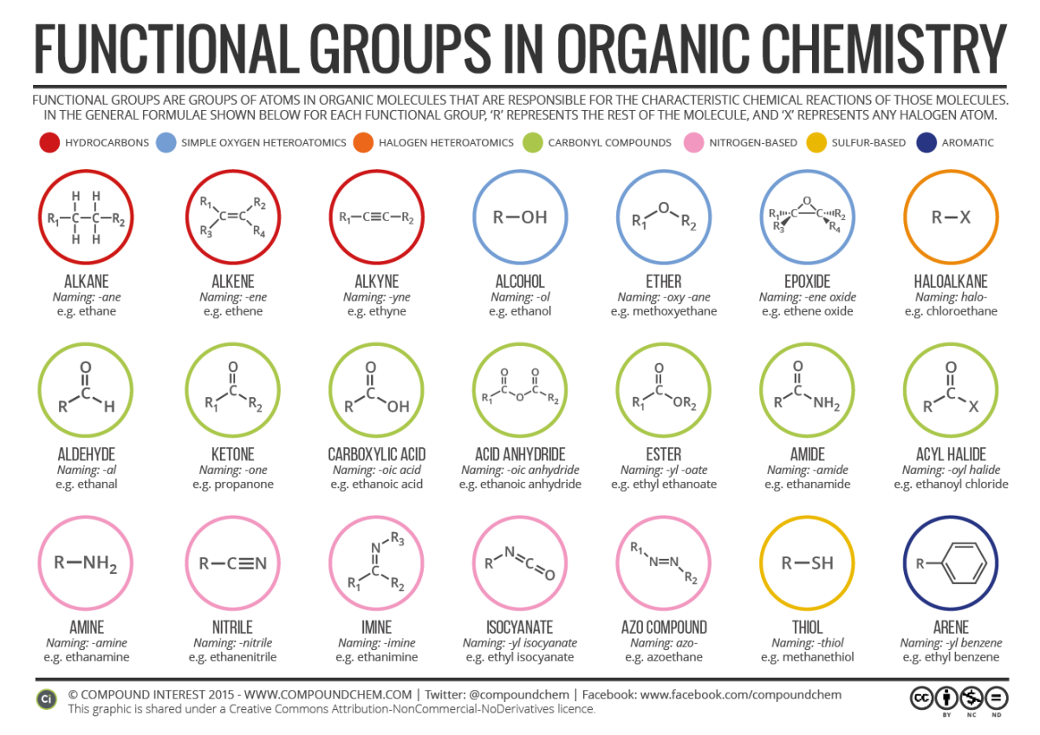
Feature Engineering
RDKit: Open-source cheminformatics software library
Canonical SMILES (2D)
Molecular Descriptors (0D)
Molecular weight, valence electrons, halogens, functional groups, etc.
Continuous values
Morgan Fingerprints (1D)
Functional groups, substituents, etc.
Binary (present or not)
Brunning, A. (2014, January 24). Functional groups in organic compounds. Compound Interest. https://www.compoundchem.com/2014/01/24/functional-groups-in-organic-compounds/
Notes:
Accessible as a python package
Developing molecular descriptors from the canonical smiles (2D descriptor)
2 types of features
Morgan fingerprinting is another great way to engineer features from the SMILES and chemical structure data. Through fingerprinting, we are often able to capture key substructures like functional groups and substituents within the chemical structure. Then the fingerprinting algorithm can assign these substructures into binary columns called bits, and this surprisingly works well with predictive models and machine learning methods.

Slide 13


Algorithms Evaluated
Linear regression algorithms
Non-linear regression algorithms
Random Forest (RF)
Support Vector Regression (SVR)
AdaBoost Regression (ADA)
Multi-layer Perceptron (MLP)
K-Nearest Neighbour (KNN)
Gradient Boosting Regression (GBR)
Decision Trees (DT)
Notes:
With that out of the way and now that we have engineered our features, we can begin to evaluate some models on our dataset. Preliminary runs of linear regression models on our dataset were... really bad. We even consulted some QSAR papers in the literature and the ones we’ve read don’t use linear models. So it was clear that this was a non-linear regression problem. These are the seven we’ve trained so far.

Slide 14
Results (cross-validation on different algos)
Regression Model | MAE | MSE | RMSE | R2
RF | 0.598 | 0.651 | 0.807 | 0.684
KNN | 0.609 | 0.700 | 0.836 | 0.660
GBR | 0.778 | 0.971 | 0.985 | 0.529
SVR | 0.845 | 1.204 | 1.097 | 0.416
ADA | 0.999 | 1.435 | 1.198 | 0.304
DT | 0.775 | 1.287 | 1.139 | 0.375
MLP | 1.216 | 2.064 | 1.436 | 0.001
Notes:
So we used the default setting provided by sci-kit learn and these are the results we obtained for the models. You can see they range from low to high. But the most promising seemed to be the random forest model. The plan was to optimize hyperparameters for every single model here but due to time constraints, we just focused on the best performing model here.

Slide 15
Results (cross-validation on different algos)
Regression Model | MAE | MSE | RMSE | R2
RF | 0.598 | 0.651 | 0.807 | 0.684
KNN | 0.609 | 0.700 | 0.836 | 0.660
GBR | 0.778 | 0.971 | 0.985 | 0.529
SVR | 0.845 | 1.204 | 1.097 | 0.416
ADA | 0.999 | 1.435 | 1.198 | 0.304
DT | 0.775 | 1.287 | 1.139 | 0.375
MLP | 1.216 | 2.064 | 1.436 | 0.001

Slide 16
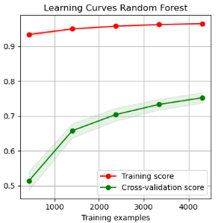
Pre-tuned Learning Curves (Random Forest)
High Training Score (overfitting)
Low CV Score (underfitting)

Slide 17
Combatting Overfitting
To address potential overfitting indicated from learning curves…
Reduce feature space - Recursive Feature Elimination (RFE)
Restrict model complexity - Hyperparameter Tuning
Can we simplify the model and achieve similar prediction accuracy?

Slide 18

RFE & Hyperparameter Tuning
184 Features
Iteratively remove based on feature importance (mean decrease gini)
50 Features
Tune Parameters
max_features
min_samples_leaf
max_depth
Best: 0.899757 using {'min_samples_leaf': 5, 'max_features': 15, 'max_depth': 20}
Notes:
We started with reducing our 184 features down to only 50 with RFE, and then concentrating on this reduced features space we attempted to tuned the following hyperparameters: we looked at max depth, max features, and max samples. We conducted a random search over 75 combinations, focusing on relatively small values for each search range. The aim here was to restrict the depth and complexity of the trees build with hopes of avoiding overfitting, while retaining as much explanatory power as possible.

Slide 19
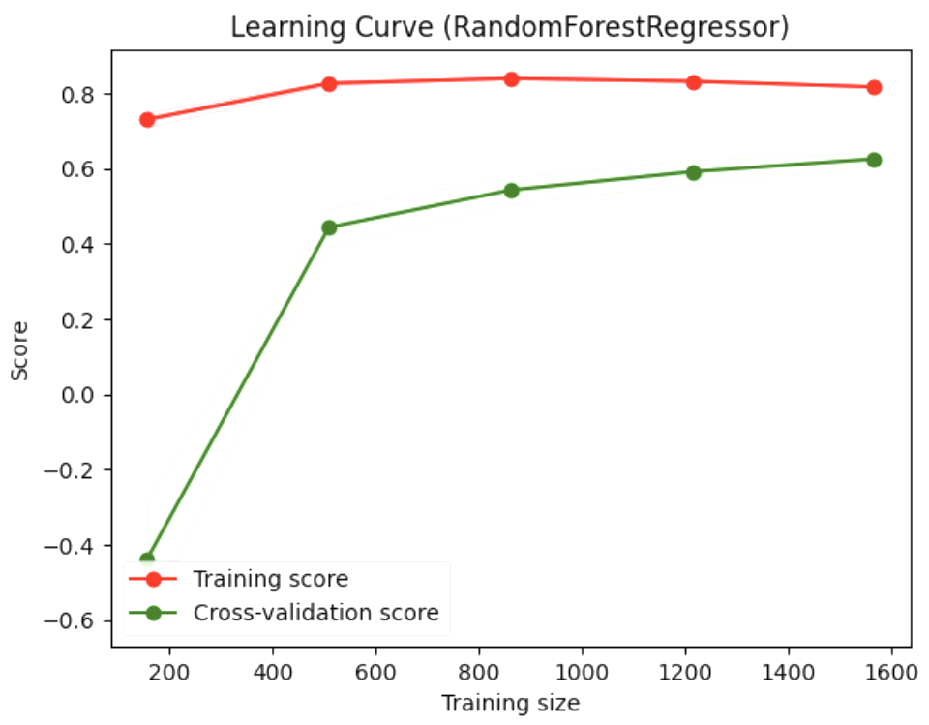
RFE & Hyperparameter Tuning
Test Set Validation
Mean Absolute Error (MAE): 0.6483
Mean Squared Error (MSE): 0.7276
Root Mean Squared Error (RMSE): 0.8530
R-squared: 0.6334
Reduced overfitting
Comparative performance on test set
Simpler model (50 versus 184 features)
01
02
03
Notes:
So, the results - we were able to …..

Slide 20
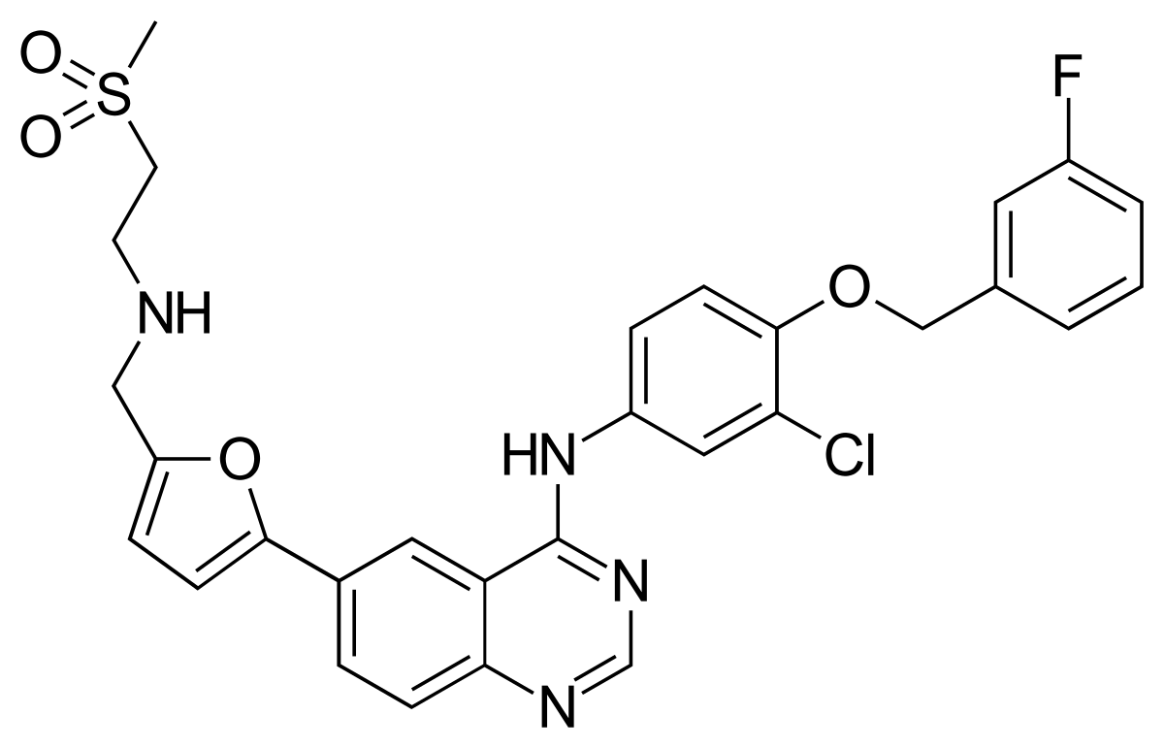
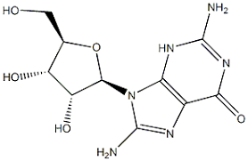
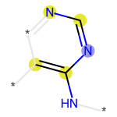

Selected Features
Fingerprints
Pyrimidine Ring (col343)
Lapatinib
Trastuzumab
Alkene
(col1366)
Physicochemical Descriptors
Abundance of molecular surface area (VSA) and Energy State (EState) descriptors.
Notes:
Among the selected features in our final model, two molecular fingerprints stand out: one, a standard alkane, which is a common component of reactive molecules in general, but another which was the pyrimidine structure. This aromatic group is present in many currently used pharmaceutical inhibitors of EGFR, including the two shown here, providing some validation for our model. We also found a high abundance of features measuring various molecular surface area (VSA) and energy state (EState) related properties, which together, are highly relevant to interactions occurring within a protein's binding pocket, influencing its stearic compatibility and reactivity - thus these make sense and their interactions, while beyond the scope of this presentation, warrant further investigation.

Slide 21
Wrapping Things Up
Key Takeaways
Effective screening tool for candidate inhibitory compounds
Complimentary to experimental high throughput screening
Contributes to fight against drug resistance and rising cancer prevalence
Limitations & Future Directions
Comprehensive algorithm/model evaluations
Incorporation of more experimental data
Integration of molecular features in docking simulations
Notes:
Computational demand prevented comprehensive evaluation of alternative algorithms - we would have liked to do hyperparameter optimization with larger grid search as well
Another limitation, evidence by our learning curves and sub par CV scores by comparison, is limited data - future work should consider incorporating such a technique on diverse datasets since chemical features and their effects on binding can in fact be modelled across many different biological targets.
Finally, molecular features identified from models like ours can be integrated with docking simulation methods, which stand to benefit tremendously from advancements in AI, helping to resolve interaction in three dimensions and essentially put a more precise predicted function for features identified as important in screening models.

Slide 22

Thanks!
RDKit Development Team
Dr. Dan Tulpan

Slide 23
References
1. Abourehab MAS, Alqahtani AM, Youssif BGM, Gouda AM. Globally Approved EGFR Inhibitors: Insights into Their Syntheses, Target Kinases, Biological Activities, Receptor Interactions, and Metabolism. Molecules. 2021 Nov 4;26(21):6677. doi: 10.3390/molecules26216677. PMID: 34771085; PMCID: PMC8587155.
2. Appert-Collin A, Hubert P, Crémel G, Bennasroune A. Role of ErbB Receptors in Cancer Cell Migration and Invasion. Front Pharmacol. 2015 Nov 24;6:283. doi: 10.3389/fphar.2015.00283. PMID: 26635612; PMCID: PMC4657385.
3. Aykul, S., & Martinez-Hackert, E. (2016). Determination of half-maximal inhibitory concentration using biosensor-based protein interaction analysis. Analytical Biochemistry, 508, 97–103. https://doi.org/10.1016/j.ab.2016.06.025
4. Bhushan A, Gonsalves A, Menon JU. Current State of Breast Cancer Diagnosis, Treatment, and Theranostics. Pharmaceutics. 2021 May 14;13(5):723. doi: 10.3390/pharmaceutics13050723. PMID: 34069059; PMCID: PMC8156889.
5. Dietterich TG. Ensemble methods in machine learning In: Goos G, Hartmanis J, Van Leeuwen JP, editors. International Workshop on Multiple Classifier Systems. Springer: 2000. p. 1–15.
6. Herbst RS. Review of epidermal growth factor receptor biology. Int J Radiat Oncol Biol Phys. 2004;59(2 Suppl):21-6. doi: 10.1016/j.ijrobp.2003.11.041. PMID: 15142631.
7. Polyak K. Heterogeneity in breast cancer. J Clin Invest. 2011 Oct;121(10):3786-8. doi: 10.1172/JCI60534. Epub 2011 Oct 3. PMID: 21965334; PMCID: PMC3195489.
8. Speck-Planche A, Kleandrova VV, Luan F, Cordeiro MN. Chemoinformatics in anti-cancer chemotherapy: multi-target QSAR model for the in silico discovery of anti-breast cancer agents. Eur J Pharm Sci. 2012 Aug 30;47(1):273-9. doi: 10.1016/j.ejps.2012.04.012. Epub 2012 Apr 17. PMID: 22538055.
9. Xiao Y, Wu J, Lin Z, Zhao X. A deep learning-based multi-model ensemble method for cancer prediction. Comput Methods Prog Biomed. 2018; 153:1–9
10. Zhao M, Wang L, Zheng L, Zhang M, Qiu C, Zhang Y, Du D, Niu B. 2D-QSAR and 3D-QSAR Analyses for EGFR Inhibitors. Biomed Res Int. 2017;2017:4649191. doi: 11.1155/2017/4649191. Epub 2017 May 29. PMID: 28630865; PMCID: PMC5467385.
11. Zdrazil, B., Felix, E., Hunter, F., Manners, E. J., Blackshaw, J., Corbett, S., de Veij, M., Ioannidis, H., Lopez, D. M., Mosquera, J. F., Magarinos, M. P., Bosc, N., Arcila, R., Kizilören, T., Gaulton, A., Bento, A. P., Adasme, M. F., Monecke, P., Landrum, G. A., & Leach, A. R. (2023). The CHEMBL database in 2023: A drug discovery platform spanning multiple bioactivity data types and time periods. Nucleic Acids Research, 52(D1). https://doi.org/10.1093/nar/gkad1004

Slide 24


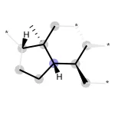
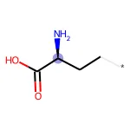
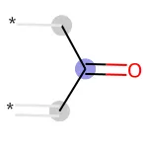

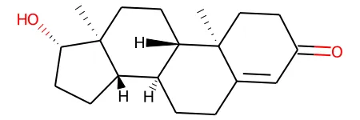
Molecular Fingerprinting Explained
AA | AT | AC
3 | 2 | 1
AAAATATAC
k-mers for DNA
N-grams for Natural Language Processing
“H | He | el
1 | 1 | 1
“Hello World!”
Bit columns for 2D Chemical Structures
Bit_1 | Bit_2 | Bit_3
1 | 0 | 1

